Slide 1
SMART
(Solutions for More Accessible Rail Transport)

Slide 2
“Don't feel safe!!!... And help to get on and off is usually not available at all stations !!!...”
“I have been knocked over onto the ground and no one has helped. I have fallen on moving
transport because no one would give me a seat.”
“Always need ramp and assistance... Staff not always there...”
“Not just the wheelchair-bound need ramps, people with Hidden disabilities, Medical issues and Visual impairment would also benefit”

Slide 3
The Problem
67% of people with mobility difficulties said that they don’t take the train as much as they would like.
Intercity Trains
360,153 people in Ireland reported to have a mobility and dexterity disability in Ireland in 2016*
DART
Conclusion: The current system deprives the user of their independence

Slide 4
The Solution

Slide 5
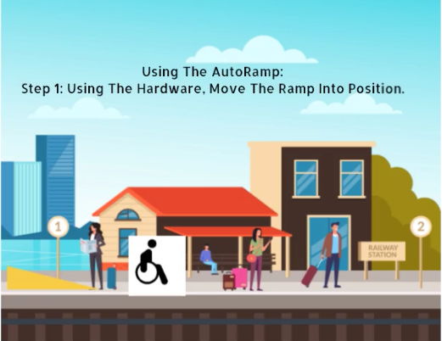
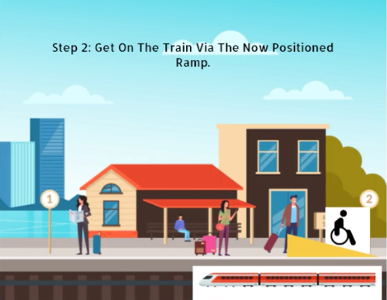
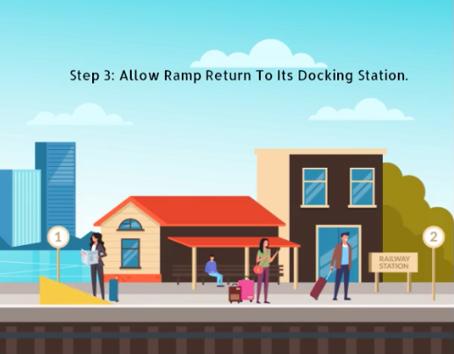
The AutoRamp

Slide 6
Plan for navigation
GPS module attached to the door.
Lights a series of LED markers until perpendicular to the door.
Pixy Cam on the AutoRamp follows the markers when button pressed.
AutoRamp turns 90 degrees when it can no longer see the markers.
AutoRamp looks for the LED marker on the door.
When AutoRamp finds the door, the jack descends the ramp until it meets the floor of the train.
AutoRamp uses its memory function to return to its docking station when indicated by the user.
AutoRamp drives until the ultrasonic on its base recognises the gap.

Slide 7
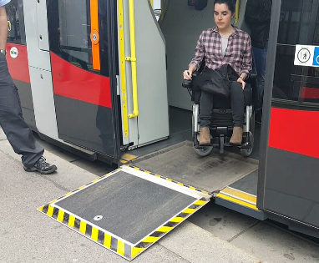
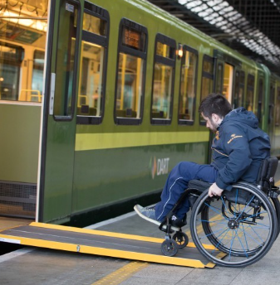
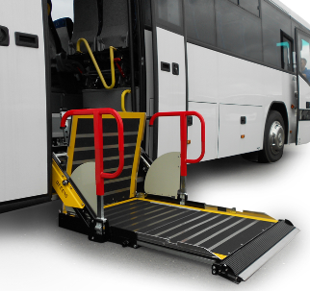
Other Options
Integrated Fold Out Ramp
Manual Ramp on the Platform
Integrated Elevator

Slide 8
Why the AutoRamp?
 | Integrated Fold Out Ramp | Integrated Elevator | Manual Ramp | AutoRamp
Returns Independence to the User
Cost Effective
Complies with Safety Regulations

Slide 9
 | Price Per Unit (€) | Price Per Train (€)
Integrated Fold Out Ramp | 150,000 | 1.8 million
Integrated Elevator | 200,000 | 2.4 million
AutoRamp | 100,000 | 100,000
Why the AutoRamp?

Slide 10
Proof of Concept

Slide 11
Our Current Sponsors

Slide 12
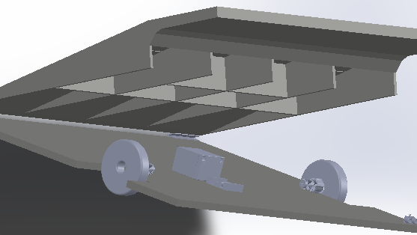
Thank You
Any Questions?

